Slide 1
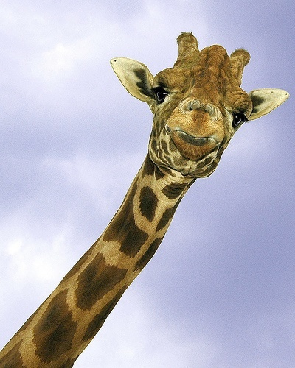
Kingdom Animalia
All animals are part of Kingdom Animalia.
Animals are multi-cellular organisms made of mostly tissues and organs.
Animals must ingest their food and digest it internally within the body.
So far, scientists have been able to discover between 9 and 10 million animal species.
Animals come in a variety of shapes, sizes, colors, and other characteristics.
Most animals on Earth are insects.

Slide 2
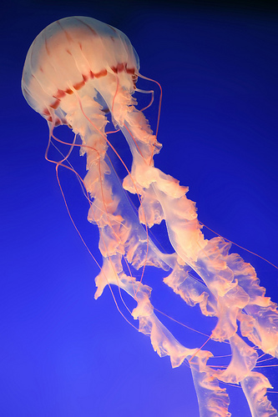
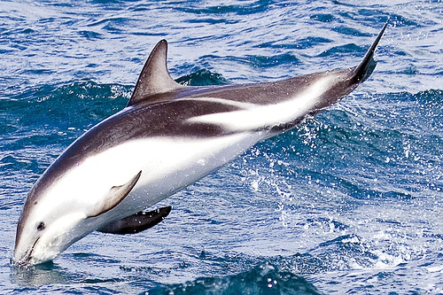
Groups
Amphibians
Birds
Fish
Insects
Mammals
Reptiles

Slide 3
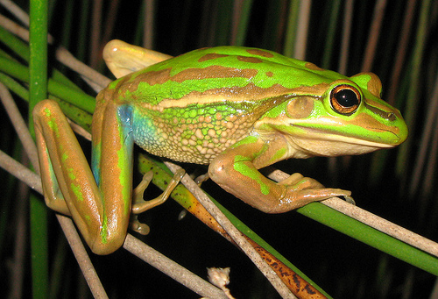
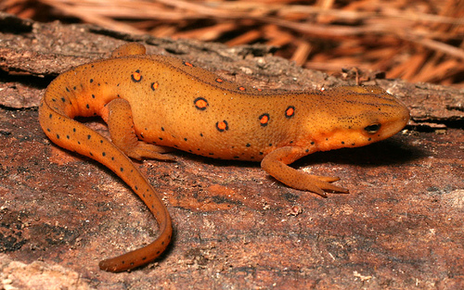
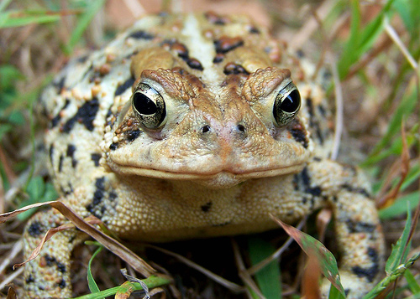
Amphibians
Groups
Amphibians are…
Cold blooded
Lay jelly-covered eggs
Breath with their gills, lungs, or
through their skin
Moist skinned creatures- they do
not have scales!
Water or moist environment
lovers.
Check Out these Amphibians!
Frogs Newts Toads

Slide 4
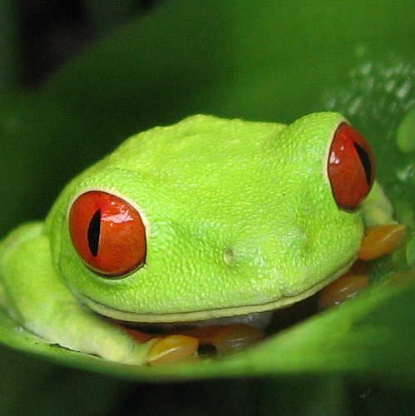
Frogs!
Amphibians
Frogs spend most of their time in the water, and only part of the time on land.
Frogs internal body temperature matches the exterior temperature.
Unlike toads, frog skins are typically smooth and moist.
Frogs will not only shed their skin- they will EAT it too!
Frogs will anything from mosquitoes, flies, worms, spiders, and sometimes other frogs.
Baby frogs are also called “tadpoles”.
The frog in the picture to the left is called a Tree Frog.
There are many different types of frogs; some are the Wood Frog, Bullfrog, Green Frog, Flying Frog, and Mountain Frog.

Slide 5
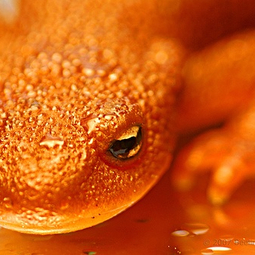
Newts!
Amphibians
Newts have permeable skin that is also toxic for self defensive purposes.
Newts usually live on a solitary basis but can hibernate in groups.
Newts can re-grow limbs!
Newts can live up to 20 years.
Newts eat water snails, insects, and especially WORMS!
Newt eggs are usually laid individually on plants.
This Newt is a North American Newt.
Newt populations are declining around the world because of pollution and loss of habitat.

Slide 6
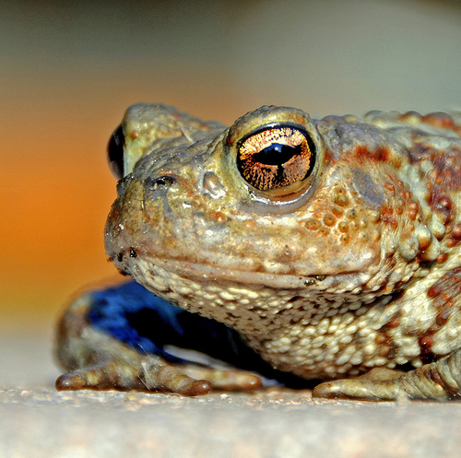
Toads!
Amphibians
Toads have wart-like skin that is dry.
Are night-hoppers.
Have poison glands behind their eyes.
Live in drier areas.
Have small tongues to catch their food.
Eat ants, flies and spiders.
Toads will lay their eggs in a chain-like
shape.
Will burrow in sandy locations if they
sense danger.
This Toad is known as the Spadefoot
Toad.

Slide 7
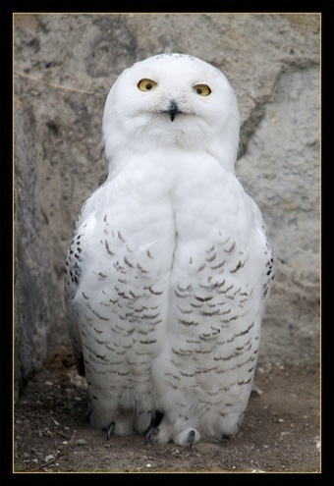
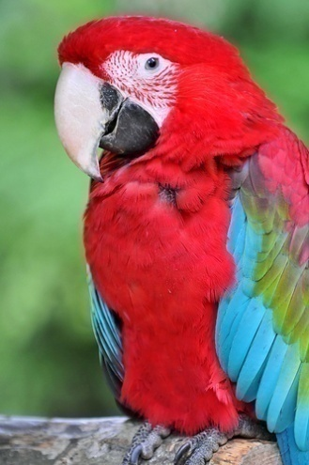
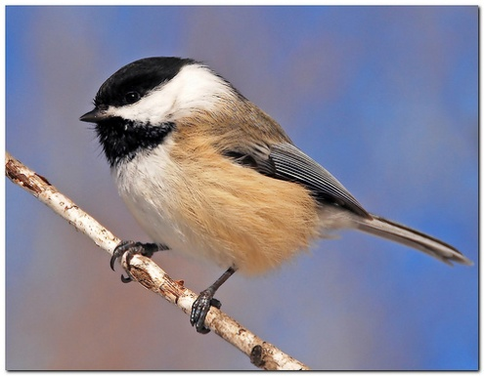
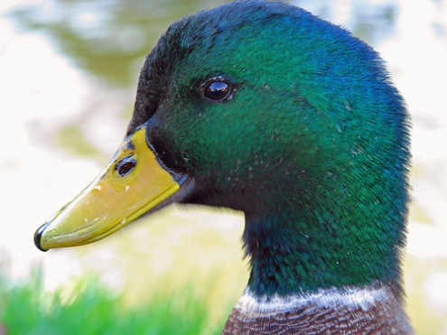
Birds
Groups
Birds are warm blooded animals.
Birds have wings, and most have the ability to fly.
Birds lay eggs that eventually hatch.
Some birds will migrate south in the fall and migrate north in the spring.
There are different groups of birds:
Arctic Tropical
Land Water
Each of these birds are birds is
an example of each bird group!
Check them out!
Snowy Owls
Macaw Parrots
Chickadee
Mallard Ducks

Slide 8
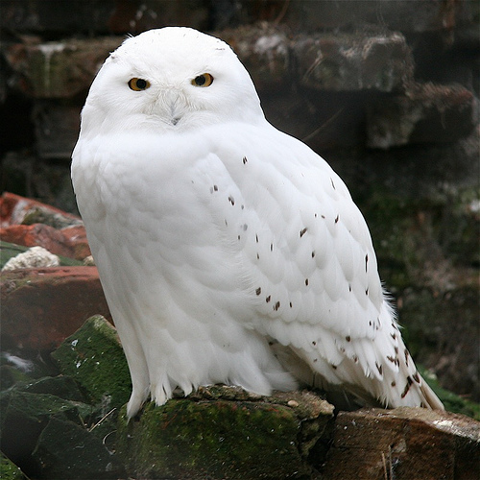
Snowy Owls!
Birds
Snowy Owls live within woodland type areas in the tundra or Arctic Circle.
Unlike some birds, Snowy Owls will build their nests on the ground.
Snowy Owls are one the largest owl breeds in the world!
These owls will swallow their food whole, and will regurgitate the bones afterwards.
Snowy Owls may eat over 2,000 mice and lemmings in one year!
Snowy Owls do not travel in flocks like some birds; they tend to lead a solitary life.

Slide 9
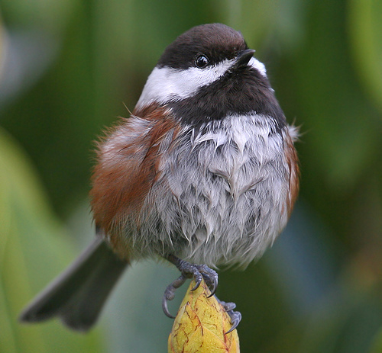
Chickadees!
Birds
Chickadees prefer to live in wooded areas such as woodlands, parks, and other like places in North America.
Female Chickadees will build their nests alone and will incubate their eggs for about 12 days.
Chickadees will eat mainly insects and spiders, but will also eat plants too.
If a Chickadee feels threatened by a predator it will gather other Chickadees to swarm the predator for protection.
Chickadees will hop rather than walk.

Slide 10
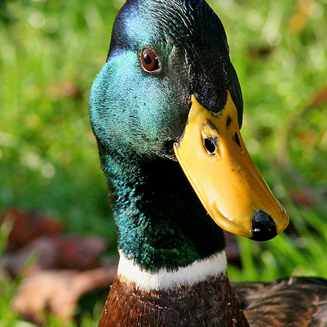
Mallard Ducks!
Birds
Mallards are by far the most well-known water-based bird in the world.
Mallards prefer to live in the wetlands, but will also live at lakes, rivers, and along the coastline.
Mallard hens (females) will lay their nest on the ground nearby water and will lay between 9 – 13 eggs.
The female duck call, also called the “decrescendo call,” can be heard for miles!
Mallards will flock in large groups south for the colder months.
This Mallard is an example of the male.

Slide 11
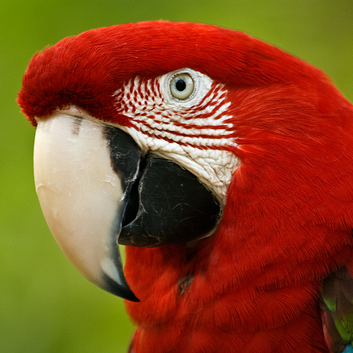
Macaws!
Birds
Scarlet Macaws mate for life with one partner; once they are mated they are rarely ever separated.
Macaw hatchlings may reside with their parents between 1 – 2 years after hatching.
Typically the Macaw will use its left foot for grasping and feeding while the right foot for balance.
In the wild Macaws live on average between 40 – 50 years. They can live on average around 75 years if living in captivity.
Macaws will prefer to eat fruits and nuts. Sometimes they will eat clay to help digest harmful chemicals.
Scarlet Macaws have a strong influence on their environment; they play a role in the generation of certain tree species.

Slide 12
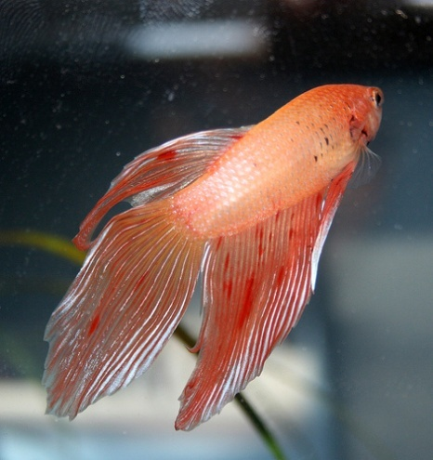
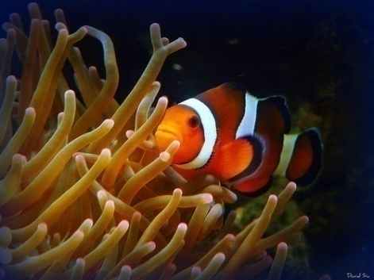
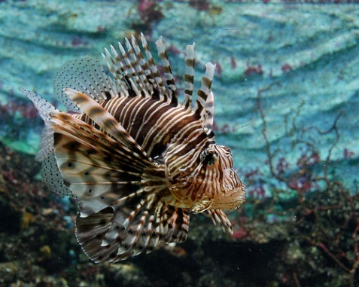
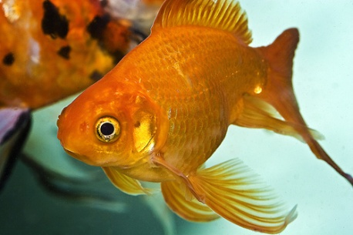
Fish
Groups
Fish are cold blooded animals.
Fish use their gills in order to breath.
Fish are covered in scales rather than skin.
Fish move around using their fins.
All fish must live in water, but not all things that live in the water are fish.
There are fresh water fish, marine fish, aquarium fish, and tropical fish.
Check out these cool fish!
Betta Fish
Clown Fish
Goldfish
Lionfish

Slide 13
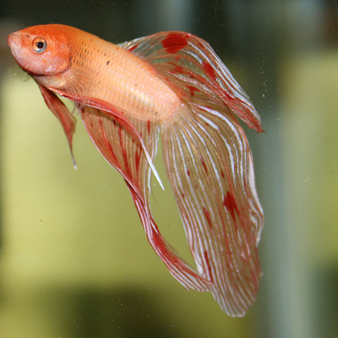
Betta Fish!
Fish
Betta fish live in watery areas that have low oxygen levels.
Betta fish can survive if the only thing left of the water they live in is muddy clay.
These fish are very aggressive; they are famous for fighting with competing Betta fish in order to protect their own territory.
The Betta will eat insects that fall into their waters; they do not usually hunt.
Bettas like to bury themselves in the sand during the dry season, and will come out again when it is more rainy.
There is not one specific color for the Betta; they are colored in layers starting with blue, red, black, and lastly yellow.

Slide 14
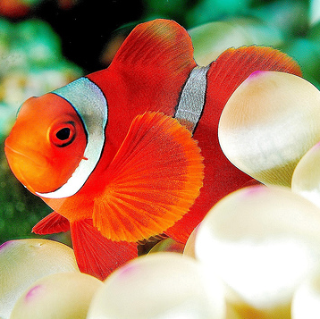
Clown Fish!
Fish
Clown Fish reside in an anemone within or near the coral reefs.
Clown Fish, like the Macaw Parrott, will mate for life with one other Clown Fish.
Male Clown Fish are the primary care provider for their eggs, but the female will also help out from time to time.
These fish can live on average between 6 to 10 years.
Clown Fish are not very good swimmers; this is why they rely on their anemone for constant shelter from predators.
These fish eat mainly algae, plankton, and even parasites that live on the anemone they live in.
Anemones are very beneficial for Clown Fish for shelter because predators risk getting stung if they come in contact with the anemone.

Slide 15
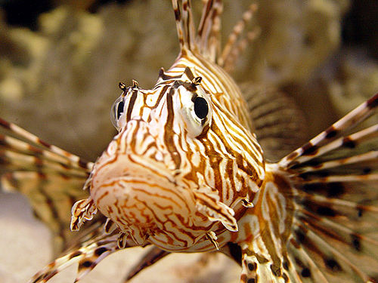
Lionfish!
Fish
Lionfish live in marine waters along reefs where the water is warm year round.
Lionfish are nighttime swimmers; when the sun comes out they go back into their dark shelter in the reefs.
These fish will eat other small fish and crustaceans, and sometimes will eat younger versions of its own species.
Lionfish attack by gliding along and grasping their prey with one BIG gulp with their open mouth.
If a Lionfish feels that its home is threatened it will charge at the intruder to bite its head.
A Lionfish’s sharp dorsal fins are poisonous; this is one of its ways for self-defense.

Slide 16
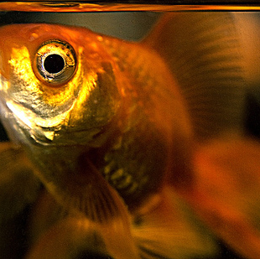
Goldfish!
Fish
Goldfish are freshwater fish that prefer to live in slow-moving waters.
These fish are by far the most popular domesticated fish that families keep as pets in an aquarium or in a pond.
The oldest living goldfish ever recorded lived to 43 years old! Goldfish kept in ponds can live up to 25 years old, and aquarium kept goldfish can live up to 10 years old.
Goldfish are omnivores; they eat plants.
The size of a goldfish depends on its living environment; the larger the habitat, the larger they grow.
Goldfish are a relative of the carp.
Goldfish teeth can be found in their throat- NOT their mouth.

Slide 17
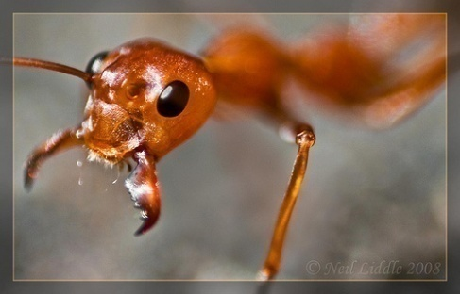
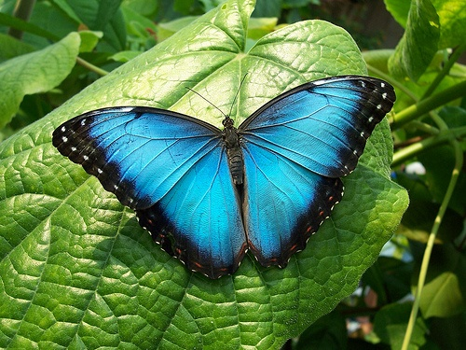
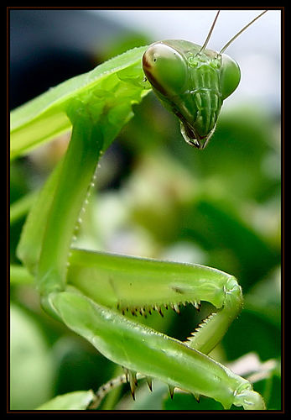
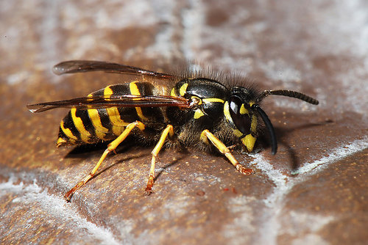
Insects
Groups
Insects are cold-blooded creatures.
Insects have three main body parts: head, thorax, and the abdomen.
Their exterior is their skeleton; it is called an exoskeleton.
Insects have antennas or feelers to help with finding food.
Insects are the largest group in the animal kingdom.
Insects can be both harmful and helpful for humans.
Check out these Insects!
Leaf-Cutting Ants
Karner Blue Butterfly
Praying Mantis
Yellow Jacket

Slide 18
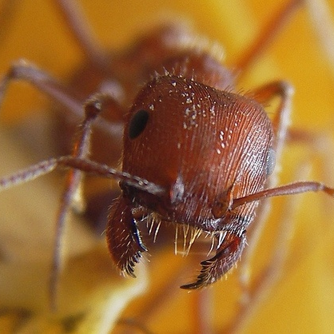
Leaf-Cutting Ants!
Insects
These ants are very aggressive about protecting their territory.
The Queen ant is the largest ant in the colony.
Only the Queen and males are able to mate, all other ants are sterile (they cannot mate).
The Queen will leave her colony to lay news eggs for a new colony to form.
The lifespan for the ant colony is closely related to the lifespan of the Queen; if the colony should survive, it can live as long as 10-15 years.
Leaf-Cutting Ants eat fungus.
Some people in Mexico will eat these types of ants as a source of protein.
Leaf-Cutting Ants live in tropical areas and other agricultural areas.

Slide 19
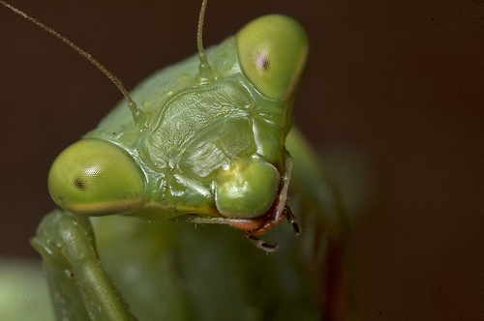
Praying Mantis!
Insects
The Praying Mantis uses surrounding leaves for camouflage and hunting their prey.
It is a rare occasion for the female mantis to bite the head off the male after mating; this typically occurs only if the male is aggressive.
The Praying Mantis is a carnivore; they eat other insects like grasshoppers, crickets, flies, wasps, spiders, and butterflies.
Female Praying Mantis’ are larger than male Praying Mantis’.
Praying Mantis are quiet and shy.

Slide 20
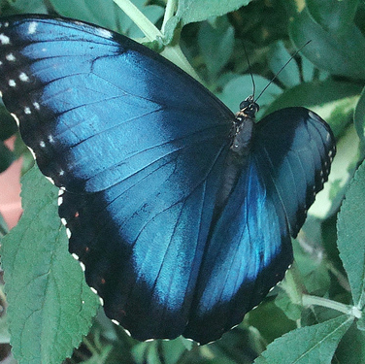
Karner Blue Butterflies!
Insects
Since 1992 the Karner Blue Butterflies have become endangered.
Like all butterflies, the Karner Blue will go through a metamorphosis: a change in physical form.
These butterflies have a short lifespan; they can survive anywhere between 4-5 days or up to 2-3 weeks.
If it is too warm the Karner Blue will remain in shaded areas until it cools off. Karner Blue Butterflies will fly around from early morning to early evening.
These butterflies will only feed on wild lupine (a blue flower).
Karner Blue Butterflies prefer to live grassland areas, but will also live in forest-type areas also.

Slide 21
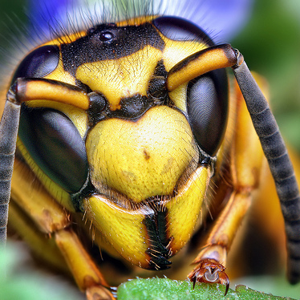
Yellow Jackets!
Insects
Many people fear that the Yellow Jacket is an aggressive insect, but actually it is quite peaceful. However, it will not resist to defend itself if it feels threatened.
A Yellow Jacket will sting profusely if they feel threatened; this can be very dangerous and sometimes fatal to some people with strong allergies.
Adult Yellow Jackets only eat nectar and fruit juices; only the larvae will eat other insects.
Yellow Jackets rely on sight and smell to find food.
Queen Yellow Jackets will live for one year, while males die shortly after mating or early in December.
The designs on the abdomen of the Yellow Jacket determine its caste (social status).

Slide 22
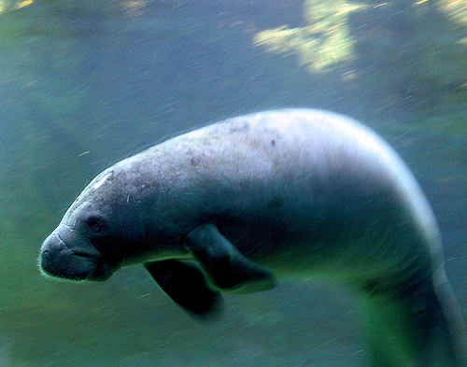
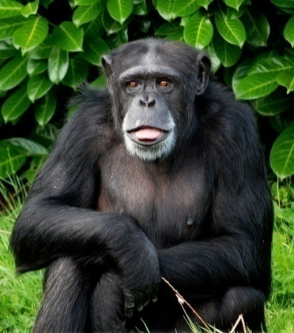
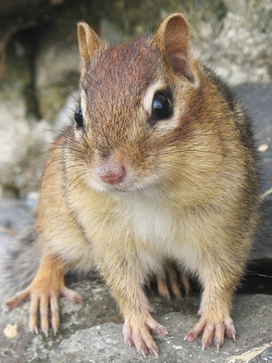
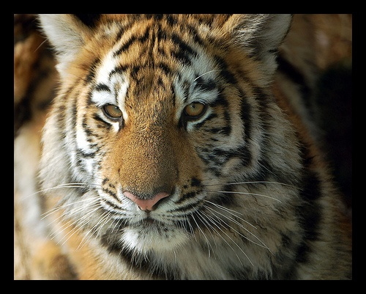
Mammals
Groups
Mammals are the most intelligent animals on Earth!
Mammals are warm-blooded.
Mammals have hair or fur to keep themselves warm.
Some mammals include wild cats, dolphins, rodents, apes, and HUMANS!
Most baby mammals will drink from their mother.
Mammals can either be carnivores, herbivores, and/or omnivores.
Check out these mammals!
Manatees
Chimpanzees
Chipmunks
Tigers

Slide 23
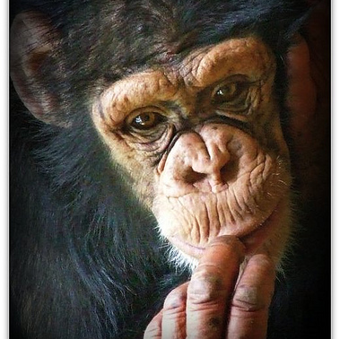
Chimpanzees!
Mammals
The Chimpanzee is the closest to human mammal; they are 99.4% identical.
The Chimpanzee is a very social creature.
Baby Chimpanzees will cling to their mothers from 3.5 to 4.5 years.
A Chimpanzees lifespan can range from 40-60 years.
Adult males have the strongest relationships within their community, however, they are most likely to compete between each other.
Chimpanzees groom each other socially to maintain cleanliness but also to strengthen relationships.
Playing is something Chimpanzees like to do at all ages.
Chimpanzees are very intelligent, only with education and training can they solve problems, learn sign language, and many other tasks.

Slide 24
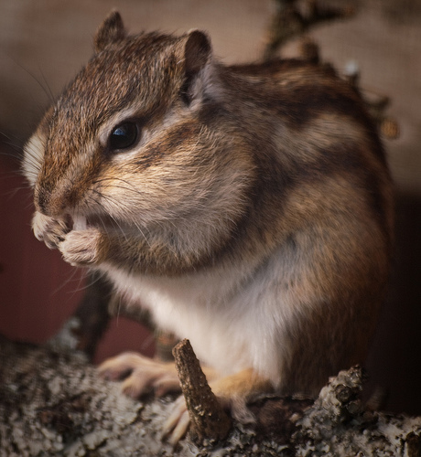
Chipmunks!
Mammals
Chipmunks have pouched cheeks so that they can store food in them.
Most Chipmunks do not live more than one year.
Chipmunks got their name by the noise they make: “Chip” noises.
This Chipmunk does not hibernate through the winter entirely; it will wake up from time to time to eat some of its stored nuts and food.
The Chipmunk prefers to eat things like nuts, corn, fruits, and seeds, but it will eat insects too.
To escape predators the Chipmunk will run fast to its burrow (home) for safety.

Slide 25
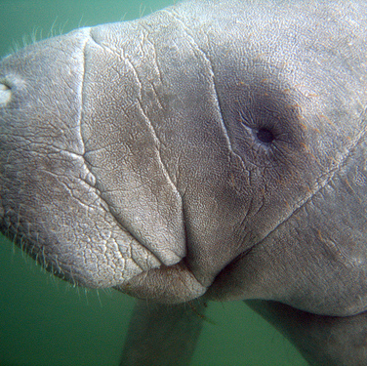
Manatees!
Mammals
The Manatee is VERY BIG! It can weigh up to 1,000 kg or 2,205 lbs.
Manatees are not able to live on land.
The Manatee can live alone or in groups that can go up to 200 other Manatees.
Manatees will only eat water-based or aquatic plants as a food source.
Manatees are an endangered species because of humans hunting them or destruction of their natural habitat.
They are also endangered because too often they are harmed or killed because of boating accidents.
The Manatee is a friendly animal; it will let humans approach them and pet them.
When other Manatees are swimming around each other they will often rub and roll along each other.

Slide 26
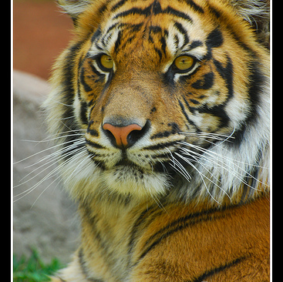
Tigers!
Mammals
Tigers have no known natural predators except humans.
Tigers are stealthy nighttime hunters.
Tigers use scent markings to communicate between each other.
The longest relationship between any tigers is between a mother and her offspring.
Tigers can live up to between 8-10 years in the wild; some tigers have been known to live into their 20s in captivity.
Tigers do not require a lot in order to survive; all they need is some vegetation for shelter, water, and prey to hunt.
All Tiger subspecies are severely endangered because of human hunting and destruction of Tigers’ habitats.

Slide 27
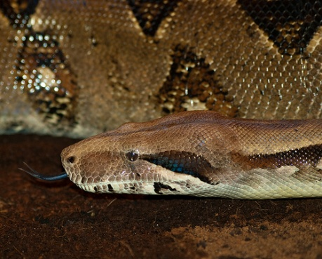
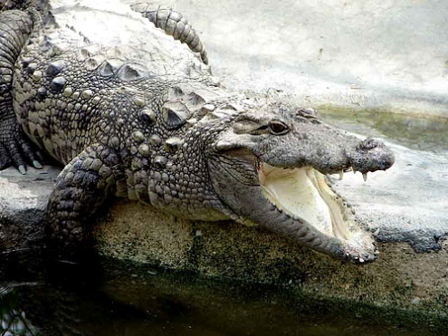
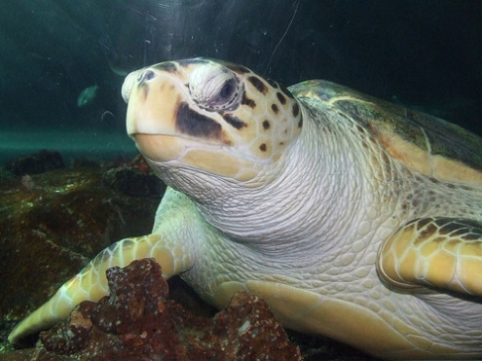
Reptiles
Groups
Boa Constrictors
Crocodiles
Sea Turtles
Reptiles are cold-blooded animals
Many Reptiles hatch from eggs when born, but others like snakes are sometimes born alive.
The Reptile’s skin is usually dry and also scaly.
Reptiles do not eat as often as other mammals.
Dinosaurs that lived long ago were Reptiles.
Many Reptiles when they grow will shed their skin.
Check out these cool Reptiles!

Slide 28
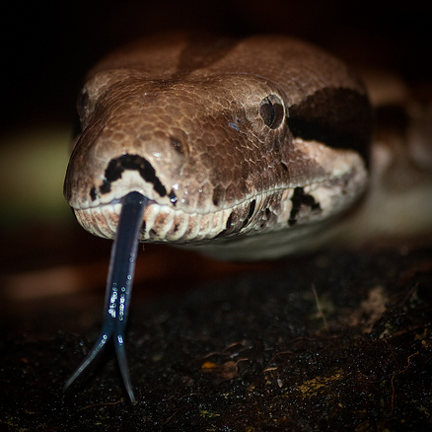
Boa Constrictors!
Reptiles
The Boa Constrictor typically lives in the Rainforest, but can also be found in woodland areas and semi-deserts.
On average the Boa is around 2.5 meters or 8.2 feet long, but can get as big as 4 meters or 13.1 feet long.
Boas can live on average 20 years in the wild and 40 years in captivity.
Most Boas prefer to be nocturnal, (nighttime creatures) but they will sunbathe if it is cold outside to keep warm.
The Boa Constrictor will eat mostly small mammals like bird and rodents; they will, however, dine on anything that can fit into their mouth if need be.
Boa Constrictors will bite if they feel threatened.
The Boa is a very popular snake to keep as a pet.

Slide 29
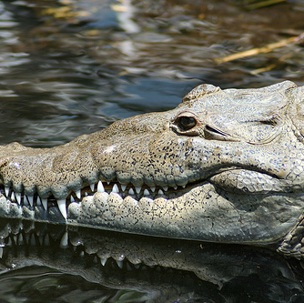
Crocodiles!
Reptiles
The Crocodile can live up to 100 years! On average in the wild most will live to 65 years old.
These Crocodiles are loners; they prefer to spend their time alone.
Crocodiles will lay in the sun with their mouths open to maintain body temperature.
The Crocodile will swallow its food whole.
Crocodiles will eat fish, turtles, small mammals, and sometimes birds.
These Reptiles are strong predators!
Most Crocodiles are active in the nighttime spending time in the water. Crocodiles prefer to remain inactive in the daylight.
The sunlight helps with their digestion.

Slide 30
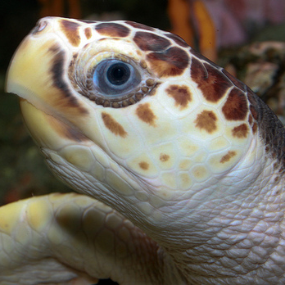
Sea Turtles!
Reptiles
In the wild, the Loggerhead Sea Turtle can live up to between 30-62 years.
Female Sea Turtles will go ashore to lay their eggs, the male will fertilize them, and then when the eggs hatch the baby turtles will swim to the ocean to find their parents.
A Loggerhead Sea Turtle can hold its breath for 20 minutes when diving, and they can go for hours without breathing.
Sea Turtles will migrate for most of their life, but will return to their feeding grounds (home base) every year.
The Sea Turtle is a carnivorous animal; it will eat things like crabs, fish, shrimp, but also plants like algae.
These Turtles will retreat into their shell when then sense danger.
Loggerhead Sea Turtles are decreasing in numbers in the North American region.

